Slide 1




Primo

Slide 2
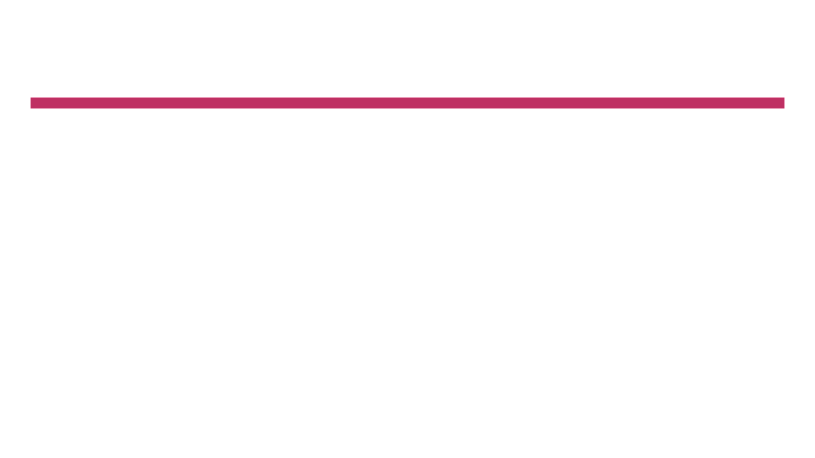
Overview
Spellcheck for Bias™ is a collaboration between the Institute and the University of Southern California’s Signal Analysis and Interpretation Laboratory (SAIL) which analyzes scripts, and manuscripts to create a breakdown of characters and dialogue. Spellcheck for Bias also incorporates Human Expert Coding to determine the representation of six identities (gender, race, LGBTQIA+, Disabilities, Age 50+ and Body Size). Spellcheck for Bias also provides an analysis of Tropes and Stereotypes and attributes as racial injustice violence, discrimination and intelligence.

Slide 3
Overview
The purpose of this report is to identify opportunities for content creators to diversify character representations. This report measures representations of six identities in the script Primo for NBC Universal:
Gender Disability
Race/Ethnicity/Latinx Age (50+)
LGBTQIA+ Body Size SizeSizeSize

Slide 4
Analysis Summary
For this report, we analyze characters who spoke 1 line of text or more. In Fat Vampire, 11 characters met this criterion. In this report we:
Identify casting opportunities for diversity and inclusion
Suggestions to avoid potential pitfalls
Suggestions to increase positive representation
Representation “tests”
Feedback on positive representation
Specified tropes and stereotypes for each identity category
Intersectional analysis of content

Slide 5
FINDINGS
Primo

Slide 6
CHARACTER NAME | LINE COUNT
RAFA | 159
ANGELA | 102
UNCLE RICK | 76
UNCLE JESSE | 50
UNCLE MANUEL | 39
UNCLE BRIAN | 37
UNCLE MATT | 33
MYA | 33
MIGUEL | 21
BETSY | 18
HARRIS | 6
Methodology

Slide 7
Gender Analysis
For comparison, women constitute 51% of the U.S. population and 50.8% of the Latinx population in the U.S.
27% of the characters are specified as female.
13% of female characters are Latinx women.
The leading character is male (“Rafa”).
The script contains 0 character opportunities to increase gender diversity.

Slide 8

Characters by Gender*
Latinx Female
Characters
Female Characters
Male Characters
Gender
Unspecified
*There were no characters that could be identified as trans and/or non-binary

Slide 9

The See Jane Test
In order to pass the See Jane Test a script/manuscript must have:
At least one prominent character (leading, co-leading, supporting character) who is a woman who;
Is not depicted with gender stereotypes or tropes.

Slide 10
Race/Ethnicity Analysis
For comparison, People of Color X Texas
90% characters are specified as characters of color.
The leading character is specified as Latinx (“Rafa”).
The script contains 1 character opportunities to increase racial/ethnic diversity.

Slide 11
Characters by Race/Ethnicity
Characters of Color
White Characters
Race/Ethnicity Unspecified

Slide 12
The Shonda Rhimes Test
In order to pass the Shonda Rhimes test a script/manuscript must have:
At least one prominent character (leading, co-leading, supporting character) who is a character of color who;
Is not depicted with race/ethnicity stereotypes or tropes.

Slide 13
Latinx Analysis
For comparison, Latinx population of Texas is 39.7%
82% characters are specified as Latinx.
The leading character is Latinx (“Rafa”).
The script contains 1 character opportunity to increase Latinx representation.

Slide 14
Characters by Race/Ethnicity
Latinx Characters
Non-Latinx
Characters
Race/Ethnicity Unspecified

Slide 15
The Salma Hayek Test
In order to pass the Salma Hayek test a script/manuscript must have:
At least one prominent character (leading, co-leading, supporting character) who is Latinx who;
Is not depicted with race/ethnicity stereotypes or tropes.

Slide 16
LGBTQIA+ Analysis
For comparison, LGBTQIA+ people comprise
5.6% of the U.S. population.
0 characters are specified as LGBTQIA+.
0 of characters are specified as LGBTQIA+ and Latinx.
The leading character is specified as heterosexual (“Rafa”).
The script contains 8 character opportunities to increase LGBTQIA+ diversity.

Slide 17
Characters by LGBTQIA+ Status
Latinx LGBTQIA+ Characters
LGBTQIA+ Characters
Heterosexual Characters
Sexuality Unspecified

Slide 18
The Vito Russo Test
Vito Russo is the founder of GLAAD.
In order to pass the Vito-Russo test a script/manuscript must have:
Contain a character that is identifiably lesbian, gay, bisexual, transgender, queer, intersex and/or asexual.
That character must not be solely or predominantly defined by their sexual orientation or gender identity (i.e. they are comprised of the same sort of unique character traits commonly used to differentiate straight/non-transgender characters from one another).
The LGBTQIA+ character must be tied into the plot in such a way that their removal would have a significant effect, meaning they are not there to simply provide colorful commentary, paint urban authenticity, or (perhaps most commonly) set up a punchline.

Slide 19
Disability Analysis
For comparison, people with disabilities constitute 19% of the U.S. population.
0 characters are specified as having a physical, cognitive, communication or mental health disability.
0 of Latinx characters are specified as having a physical, cognitive, communication, or mental health disability.
The leading character is not specified as having a disability (“Rafa”).
The script contains 11 character opportunities to increase disability diversity.

Slide 20
Characters by Disability Status
Disabled
Disability Status Unspecified

Slide 21
The Marlee Matlin Test
In order to pass the Marlee Matlin test a script/manuscript must have:
At least one prominent character (leading, co-leading, supporting character) with a physical, cognitive, communication or mental health disability who;
Is not depicted with disability stereotypes or tropes.

Slide 22
Age (50+) Analysis
For comparison, people ages 50+ comprise
34% of the U.S. population.
0 characters are specified as 50+.
The leading character is specified as under 50 (“Rafa”).
The script contains 1 character opportunity to increase age diversity.

Slide 23
Characters by Age 50+
Latinx Characters 50+
Characters 50+
Characters Under 50
Age Unspecified

Slide 24
The Betty White Test
In order to pass the Betty White test a script/manuscript must have:
At least one prominent character (leading, co-leading, supporting character) who is 50+ who;
Is not depicted with age stereotypes or tropes.

Slide 25
Body Size Analysis
For comparison, people with large body types constitute 39% of the U.S. population.
0 characters are specified as having a large body type.
0 of Latinx characters are specified as having a large body type.
The leading character is not specified as having a larger body type (“Rafa”).
The script contains 10 character opportunities to increase body type diversity.

Slide 26
Characters by Body Size
Characters with Large Body Type
Characters with Small/ Medium Body Type
Body Size Unspecified

Slide 27
The Lizzo Test
In order to pass the Lizzo test a script/manuscript must have:
At least one prominent character (leading, co-leading, supporting character) with a large body type who;
Is not depicted with sizeist stereotypes or tropes.

Slide 28


Overall Representation Tests
GENDER
RACE/ETHNICITY
LGBTQIA+
DISABILITY
AGE (50+)
BODY SIZE

Slide 29
Intersectional Analysis
 | Female Character | Character of Color | LGBTQIA+ Character | Character with Disability | Character 50+ | Large Body Type
Female Character |  | Yes | No | No | No | No
Character of Color | Yes |  | No | No | No | No
LGBTQIA+ Character | No | No |  | No | No | No
Disabled Character | No | No | No |  | No | No
Character 50+ | No | No | No | No |  | No
Large Body Type | No | No | No | No | No

Slide 30
Latinx Intersectional Analysis
 | Female Character | LGBTQIA+ Character | Character with Disability | Character 50+ | Large Body Type
Female Character | Yes | No | No | No | No
LGBTQIA+ Character | No |  | No | No | No
Character with Disability | No | No |  | No | No
Character 50+ | No | No | No |  | No
Large Body Type | No | No | No | No

Slide 31
Positive Aspects: Gender
Healthy Family Relationships
The film depicts a healthy family that generally communicates well. People have each other’s backs. The uncles support Rafa’s decision even if they don’t agree with it or totally understand it.
Highlights racial and economic disparity in college admissions
“College is for white people and rich Asians” (pp.8)
Depicts a Latinx kid becoming the first person in his family to pursue a college degree and the challenges associated with making that decision. Depicts the importance of supportive friends, family, school personnel, and programming to the decision making process.

Slide 32
Potential Pitfalls: Gender
Unidimensional Female Characters
The female characters in the script are developed primarily in terms of their relationships to male characters. There is no dialogue between female characters; it does not pass the Bechdel test.
While male characters have well-developed personalities, female characters are unidimensional (the mother is ‘whip smart’ and giving glaring looks to the men in her life, Mya doesn’t have many personal traits), “MATERNAL” (getting Rafa a suit and throwing parties, helping Miguel get into college), or a love interest (Mya).

Slide 33
Potential Pitfalls: Race & Class
Relies on Standardized Tests for a Student’s Worth/Status
Rafa, through no intentional effort, gets a high score on the PSAT. While it is important to show Latinx persons doing well in school--the script suggests that Rafa is “naturally” smart and that the PSAT will capture the ‘natural intelligence of POC’.
Most people who take the SAT study for years, tend to be wealthy, and the test tends to reflect cultural expressions dominant in white society. These story choices may reinforce existing bases for inequality in college admissions.
The attention the guidance counselor gives Rafa, shows that only the ‘naturally smart POC’ ‘deserve’ the limited resources and support needed to go to college.
Suggestion: The counselor or school should pay attention to Miguel (a less ‘naturally gifted’) student and he should be encouraged in school as well.
Suggestion: Using language highlighting the inequalities involving SAT and college admissions is powerful, as well as showing Rafa studying hard without access to tutors or expensive college consultants.

Slide 34
Potential Pitfalls: Size
Potential Casting Pitfall:
If Uncle Rick is cast as a larger body type he will embody size-based tropes and stereotypes.

Slide 35
Positives: Latinx Analysis
Diverse vocations, interests, and opinions among male Latinx characters
One uncle is described as a hippy, one is low-level corporate, another is a workout buff, one is interested in films
Authentic Representation
Show focuses on a working class Latinx family and has honest conversations about college affordability, choosing to go to college, growing up in a multigenerational household.
Shows dignified characters without higher education
Shows several characters that did not go to college but are doing well (e.g., Uncle has “two bathrooms”).

Slide 36
Positives: Latinx Analysis
Challenges Latinx tropes and stereotypes
Show engages with antiquated notions of “MALE MACHISMO”/”TOXIC MASCULINITY” and directly challenges it through the satirization of Rafa’s Uncle’s behavior (pp.5).
“You don’t really think you take care of your mom” (pp. 30)
Rafa subverts the “MALE MACHISTA” trope and presents a healthy depiction of masculinity. He is considerate, listens to others, asks for advice, respects the women in his life, is “sweet, nervous, well-intentioned”.

Slide 37
Potential Pitfalls: Latinx Analysis
Avoid exclusively stereotypical sources of humor
Relies almost exclusively on “MALE MACHISTA” trope for comedy among the uncles, which is an important trope to highlight, however the script may want to consider using the uncles to also subvert other tropes or have other humorous moments with alternative subject matter.
Avoid exclusively stereotypical depiction of Latinx families
If Miguel’s family is depicted in later episodes it is important to show Latinx families that are not exclusively “MULTIGENERATIONAL” and “LOUD”.
Suggestion: show the richness of Latinx culture and family-makeups when episodes feature Miguel’s family.

